Slide 1
Online Shopping System
Objectives
Model products, customers and orders as an object-oriented system
Apply classes and objects, inheritance and polymorphism, encapsulation and abstraction to a real requirement
Critically evaluate the design: strengths, limitations, alternatives and scalability
Coursework Presentation
Object-Oriented Design and Implementation in Python
Rojbin Karakoc Celik
Student ID: 42372
31 August 2026
1 / 13
Notes:
Good morning. This presentation walks through the design of a small Online Shopping System in Python that manages products, customers and orders. It was built to show core object-oriented principles in practice. I will move through the concepts in the order they build on each other - classes and objects, the object life-cycle, inheritance and polymorphism, abstraction, encapsulation and abstract data types - and on each slide I point out one design decision and its trade-off. I finish with a critical evaluation. The full source file is submitted with the slides and every snippet comes from it.

Slide 2
CLASSES & OBJECTS
Defining Classes and Objects
A class is a blueprint; an object is a live instance that owns its own state
Three domain entities: Product (catalogue item), Customer (buyer), Order (the transaction that links them)
Order references Product objects rather than copying their data, so there is one source of truth for price and stock
Each class maps to one noun in the requirement, which keeps responsibilities small and testable
class Product: # catalogue item
def __init__(self, product_id, name, price, stock):
self._name, self._price = name, price
self._stock = stock
class Customer: # registered buyer
def __init__(self, customer_id, name, email):
self._name, self._email = name, email
self._orders = []
class Order: # the transaction
def __init__(self, customer):
self._customer = customer # has-a Customer
self._items = [] # (item, qty) pairs
self._status = "PENDING"
# Objects: concrete instances with their own state
laptop = Product(1, "Laptop", 999.0, stock=5)
alice = Customer(1, "Alice", "alice@example.com")
order = Order(alice)
Trade-off Composition (Order has-a Customer, has-many items) avoids duplicated data, but it ties an Order's lifetime to the Product objects it references. A persisted system would store product IDs instead.
Simplified skeletons - the full classes appear on slides 3-10
2 / 13
Notes:
Three classes mirror the three nouns in the brief: Product, Customer and Order. A class is only a blueprint; the last three lines create real objects, each with its own state, so two Products can hold different stock while sharing behaviour. The key decision is that an Order does not copy product data. It holds references to Product objects plus a quantity, which gives a single source of truth: a price change is visible to every pending order, and stock is decremented on the real object. The trade-off is coupling - the Order depends on the Product instance staying alive, which is fine in memory but would become an ID reference once a database is introduced.

Slide 3
OBJECT LIFE-CYCLE
Constructors and Destructors
Constructor __init__
Destructor __del__
class Product(Orderable):
def __init__(self, product_id, name, price, stock):
# validate first: never start invalid
if price < 0:
raise ValueError("Price cannot be negative")
if stock < 0:
raise ValueError("Stock cannot be negative")
self.__product_id = product_id
self._name, self._price = name, price
self._stock = stock
class Order:
def __del__(self):
"""Runs when the garbage collector
frees the object. Safety net only."""
if self._status == "PENDING" and self._items:
print(f"[GC] Order #{self._order_id} "
"discarded -> releasing stock")
self.cancel()
output
Mouse stock while pending: 45
[GC] Order #1002 discarded while pending -> releasing stock
Mouse stock after GC: 48
Runs automatically on creation and establishes every invariant
Validation in the constructor means no code path can produce a Product with negative price or stock
Evaluation Python's __del__ is not deterministic: CPython frees on reference count, but objects in cycles wait for the cyclic collector. Explicit cancel() is therefore the real clean-up path; __del__ only illustrates the concept.
3 / 13
Notes:
Constructors and destructors bracket an object's life. The constructor __init__ validates every argument before storing it, so a Product can never exist with a negative price or stock - the first line of defence for data integrity. The destructor __del__ runs when the garbage collector frees the object; in Order it releases reserved stock if the order was abandoned while pending, and the output shows the mouse stock going back up. Critically, this is a safety net, not the design. CPython frees most objects immediately by reference counting, but objects in a cycle wait for the cyclic collector, so timing is not guaranteed. That is why Order has an explicit cancel() method, which is what production code should rely on.

Slide 4
STATE & BEHAVIOUR
Class Methods and Instance Variables
Instance variables (_items, _status, _order_id) belong to one object
Class variables (_next_id) are shared by every Order - used here as an ID counter
@classmethod from_cart() is an alternative constructor that receives the class, not an instance
add_item() reserves stock before appending, so a failed add leaves the order untouched
total_cost() = subtotal minus the discount the customer object decides
class Order:
_next_id = 1000 # class variable
def __init__(self, customer):
self._order_id = Order._next_id # instance var
Order._next_id += 1
self._customer, self._items = customer, []
@classmethod # alt. constructor
def from_cart(cls, customer, cart):
order = cls(customer)
for item, qty in cart.lines():
order.add_item(item, qty)
cart.clear()
return order
def add_item(self, item, quantity=1):
item.reserve(quantity) # raises if unavailable
self._items.append((item, quantity))
def total_cost(self):
sub = sum(i.get_price() * q for i, q in self._items)
disc = self._customer.calculate_discount(sub)
return round(sub - disc, 2)
Trade-off Stock is decremented when an item is added, not at checkout. Simple and consistent, but an abandoned order holds stock until cancel() runs - a timeout would be needed at scale.
4 / 13
Notes:
Two kinds of state live in Order. Instance variables such as the item list and status are unique to each order. The class variable _next_id is shared by the whole class and incremented in the constructor, giving every order a unique ID without an external counter. from_cart is a @classmethod: it receives the class, not an instance, and acts as an alternative constructor that builds an Order from a ShoppingCart. add_item calls reserve first and only appends the line if that succeeds, so asking for more stock than exists leaves the order unchanged. total_cost asks the customer object for its discount instead of checking its type - the hook for polymorphism on slide 6. Trade-off: stock is committed at add time, so a real shop would add a reservation timeout.

Slide 5
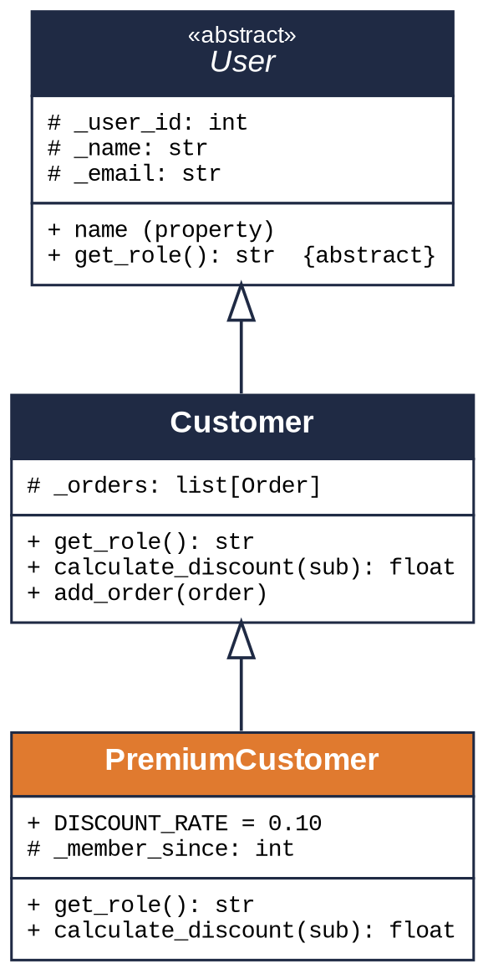
INHERITANCE
Understanding Inheritance Relationships
class Customer(User):
def __init__(self, customer_id, name, email):
super().__init__(customer_id, name, email)
self._orders = []
def get_role(self):
return "Customer"
def calculate_discount(self, subtotal):
return 0.0 # default: none
class PremiumCustomer(Customer): # is-a Customer
DISCOUNT_RATE = 0.10
def __init__(self, customer_id, name, email,
member_since):
super().__init__(customer_id, name, email)
self._member_since = member_since
PremiumCustomer is-a Customer: it inherits identity, order history and add_order()
super().__init__ reuses the parent constructor, so e-mail validation is written once
A PremiumCustomer is accepted anywhere a Customer is expected
Only the difference (an extra attribute and a new discount rule) is written in the subclass
Why inheritance here? Premium is a genuine sub-type: same interface, different pricing. If tiers multiplied (seasonal, staff, student) a Strategy object injected into Customer would scale better than a deepening class tree (Gamma et al., 1994).
5 / 13
Notes:
Inheritance models an is-a relationship. The diagram shows the chain: User is abstract, Customer is the concrete buyer, PremiumCustomer specialises Customer. In the code PremiumCustomer calls super().__init__, so e-mail validation and the order list come from the parents; the subclass only adds the membership year and a discount rate. Because it keeps the parent's interface, an Order can hold either type without knowing which. I chose inheritance because a premium customer really is a customer in every respect except pricing. My evaluation is that this stops scaling if pricing rules multiply, since every tier becomes a subclass. The alternative is the Strategy pattern, where the discount rule is a separate object - I return to that in the conclusion.

Slide 6
POLYMORPHISM
Method Overriding and Polymorphic Behaviour
class PremiumCustomer(Customer):
def get_role(self): # override
return "Premium Customer"
def calculate_discount(self, subtotal): # override
rate = self.DISCOUNT_RATE
if datetime.now().year - self._member_since >= 5:
rate += 0.05 # loyalty bonus
return round(subtotal * rate, 2)
# One call, two behaviours - resolved at run time
for customer in (alice, bob):
print(customer, customer.calculate_discount(1000))
# Order never inspects the customer's type
def total_cost(self):
sub = self.subtotal()
return sub - self._customer.calculate_discount(sub)
Overriding: the subclass replaces the parent's method with the same name and signature
Polymorphism: Order calls calculate_discount() through the base type and Python dispatches to the right version at run time
No isinstance() checks anywhere - adding a new customer tier needs zero edits to Order (open/closed principle)
Evaluation Python resolves the call dynamically and has no @Override keyword, so a misspelled method name silently creates a new method instead of overriding. Unit tests or a type checker catch this.
output
Customer: Alice <alice@example.com> discount = 0.00
Premium Customer: Bob <bob@example.com> discount = 150.00
6 / 13
Notes:
PremiumCustomer overrides two inherited methods: get_role and calculate_discount. The override keeps the same signature but changes behaviour - ten percent off plus a loyalty bonus after five years. Polymorphism is what makes this useful: the loop calls the same method on two objects and gets two results, Alice with no discount and Bob with 150. More importantly, Order calls calculate_discount through the base type and never checks which subclass it has, so a new customer tier is one new class and no changes elsewhere - the open/closed principle in practice. One limitation: Python resolves the override at run time and has no override keyword, so a typo would silently create a new method. In Java the compiler would flag it; here I rely on tests or a type checker.

Slide 7
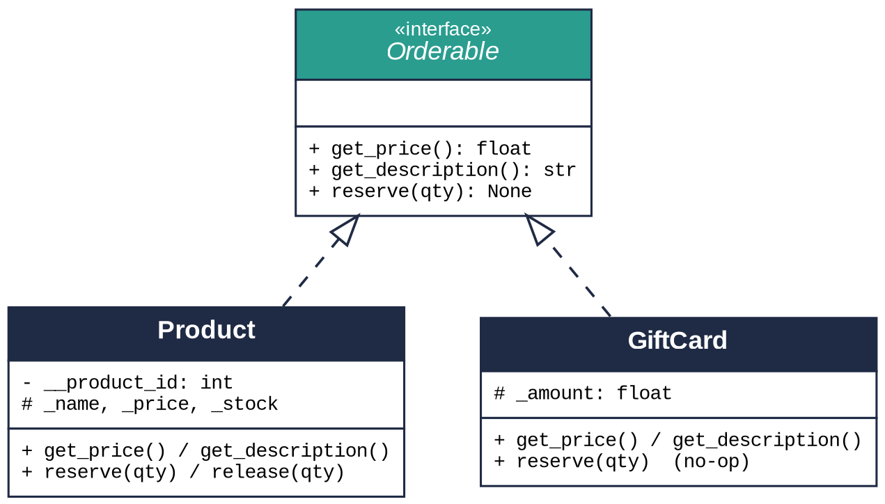
ABSTRACTION
Abstract Class User and Interface Orderable
from abc import ABC, abstractmethod
class User(ABC): # abstract class
def __init__(self, user_id, name, email):
if "@" not in email:
raise ValueError("Invalid e-mail address")
self._user_id, self._name = user_id, name
self._email = email
@abstractmethod
def get_role(self) -> str: ... # contract
def __str__(self): # shared code
return f"{self.get_role()}: {self._name}"
class Orderable(ABC): # "interface"
@abstractmethod
def get_price(self) -> float: ...
@abstractmethod
def get_description(self) -> str: ...
@abstractmethod
def reserve(self, quantity: int) -> None: ...
Abstract class: shared state and code plus a contract - User(...) raises TypeError
Interface: contract only, no state - Orderable is an ABC with nothing but abstract methods
Product and GiftCard both satisfy Orderable, so Order can hold either
Alternative typing.Protocol (PEP 544) gives the same contract structurally, without inheritance. ABC was chosen because it fails loudly at instantiation, which suits a system where data integrity matters.
7 / 13
Notes:
Abstraction separates what an object does from how. User is an abstract base class: it holds the identity fields and the shared __str__ but marks get_role as abstract, so a bare User cannot be instantiated - the demo raises a TypeError. Orderable plays the role of an interface. Python has no interface keyword, so an ABC containing only abstract methods is the idiomatic equivalent: three methods any item in an order must provide. The diagram shows two implementations, Product with stock and GiftCard without, and Order can hold either. The modern alternative is typing.Protocol, which defines the contract structurally. I chose the ABC because the failure is immediate and loud; for a library consumed by third parties the Protocol would be less intrusive.

Slide 8
DATA HIDING
Access Modifiers and Data Hiding
Convention | Meaning | Used for | Enforced?
name | public | DISCOUNT_RATE, methods | n/a
_name | protected - internal, subclasses may use | _price, _orders, _status | By convention only
__name | private - name-mangled to _Class__name | __product_id, __lines | Partially (mangling)
class Product(Orderable):
def __init__(self, product_id, name, price, stock):
self.__product_id = product_id # private
self._price = price # protected
@property
def product_id(self): # read-only
return self.__product_id
@property
def price(self):
return self._price
@price.setter
def price(self, value): # validated write
if value < 0:
raise ValueError("Price cannot be negative")
self._price = value
Attributes are never written directly from outside; every write goes through a validating setter
The product ID is private because it must never change once assigned
Read-only properties (stock, product_id) expose state without giving up control
Evaluation Python enforces access by convention, not by the compiler (unlike Java's private). Name mangling prevents accidental access and subclass name clashes, not deliberate access - integrity therefore relies on validating properties.
output
>>> laptop.price = -1
ValueError: Price cannot be negative
>>> laptop.__product_id
AttributeError # stored as _Product__product_id
8 / 13
Notes:
Python has no public, protected or private keywords; it uses the naming conventions in the table. A single underscore marks an attribute as internal; a double underscore triggers name mangling, so __product_id is stored as _Product__product_id and cannot be reached by accident. In the code, price is a protected attribute exposed through a property: reading is free, but writing goes through a setter that rejects negative values, and the output shows both the rejected write and the mangled attribute. The honest evaluation is that none of this is enforced by the compiler; a determined caller can still reach the mangled name. What the conventions give you is protection from mistakes, so data integrity rests on the properties - every state change passes through one validated path.

Slide 9
ENCAPSULATION
Encapsulation and Information Hiding
class ShoppingCart:
def __init__(self):
self.__lines = {} # id(item) -> [item, qty]
def add(self, item, quantity=1):
if quantity <= 0:
raise ValueError("Quantity must be positive")
key = id(item)
if key in self.__lines:
self.__lines[key][1] += quantity
else:
self.__lines[key] = [item, quantity]
def lines(self):
# snapshot copy: callers never touch the dict
return [(i, q) for i, q in self.__lines.values()]
class Customer(User):
@property
def orders(self):
return tuple(self._orders) # immutable view
Encapsulation
Data and the methods that operate on it live in one unit. The cart's dictionary and the rules for adding to it cannot drift apart.
Information hiding
Callers depend only on add(), remove(), lines(). The dictionary could become a list or a database table with zero changes outside the class. Copies and tuples are returned so external code cannot mutate internal state.
Invariants (quantity > 0, price >= 0) are checked in one place
Merging duplicate lines is a detail callers never see
Trade-off Returning a copy on every lines() / orders call is O(n). Fine at cart scale; for a large order history a read-only view (types.MappingProxyType) or pagination would replace the copy.
9 / 13
Notes:
Encapsulation and information hiding are related but distinct. Encapsulation means data and its operations are bundled in one class: ShoppingCart keeps the dictionary of lines and the rule that quantities must be positive together, so they cannot drift apart. Information hiding is about what callers may depend on. Nothing outside ShoppingCart knows it uses a dictionary; it could switch to a list or a database table and Order.from_cart would not change, because it only calls lines(). Customer.orders follows the same idea by returning a tuple, so nobody can append to the history from outside. The cost is a copy on every read - negligible for a cart, but for thousands of orders I would use a read-only proxy or paginate.

Slide 10
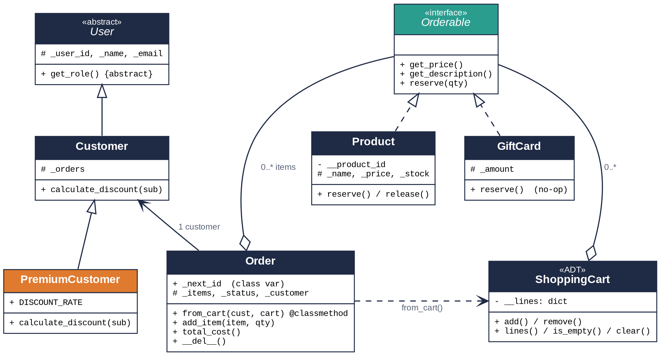
ABSTRACT DATA TYPES
Abstract Data Types and Interfaces
An ADT is defined by its operations and their behaviour, not by storage: ShoppingCart = add, remove, lines, is_empty, clear
Orderable is the interface that lets Order and ShoppingCart hold Products and GiftCards interchangeably
Order.from_cart() joins two abstractions through public operations only
A new item type (e.g. Subscription) is one new class; Order, ShoppingCart and Customer are untouched
Reusability Order depends on Orderable, never on Product. A database-backed product class that honours the three methods can replace Product without any change to ordering logic - the design is open to extension and closed to modification.
10 / 13
Notes:
This is the full class diagram: the inheritance chain on the left, the Orderable interface at the top with its two implementations, and Order and ShoppingCart at the bottom holding items through that interface. ShoppingCart is the abstract data type. An ADT is specified by what you can do with it - add, remove, list, check emptiness, clear - and how those operations behave together, not by how data is stored. That is exactly what lets the representation change. Orderable is what makes the design flexible: because Order only calls get_price, get_description and reserve, a gift card without stock and a physical product go through identical code. The reuse test is simple - adding a new item type or customer tier means one new class and nothing else.

Slide 11
CONCLUSION
Recap and Critical Evaluation
Classes & Objects
Inheritance & Polymorphism
Encapsulation
Abstraction
Product, Customer, Order model the domain; constructors guarantee valid state
PremiumCustomer overrides calculate_discount(); Order dispatches without type checks
Validated properties and hidden representation (ShoppingCart) protect integrity
Abstract User and the Orderable interface decouple ordering from concrete items
Strengths
Limitations
Improvements & scalability
Invalid state is impossible: every write is validated in one place
New tiers or item types need no edits to Order (open/closed)
Standard library only; every concept maps to a named construct
float for money - rounding drift; decimal.Decimal is the correct type
Stock reserved at add-time and released by cancel()/GC - not deterministic
In-memory only: no persistence, concurrency control or IDs across runs
Strategy pattern for discounts instead of a subclass per tier
@dataclass for Product/GiftCard; typing.Protocol for interfaces
Repository layer over a database; reservation timeouts for stock
11 / 13
Notes:
To recap: each pillar solved a concrete requirement. Classes and objects gave a domain model whose constructors make invalid state impossible. Inheritance and polymorphism let a premium customer change pricing without touching Order. Encapsulation, through validated properties and a hidden cart representation, delivers the data integrity the brief asks for. Abstraction, through User and Orderable, keeps the design open to future enhancements. Evaluating honestly: the strengths are correctness and extensibility. The limitations are real - float is the wrong type for money and should be Decimal; stock release relies on cancellation or garbage collection; and everything lives in memory. To scale it I would introduce the Strategy pattern for discounts, dataclasses to cut boilerplate, and a repository layer over a database with reservation timeouts. The abstractions chosen now are what make those changes local rather than system-wide.

Slide 12
Q&A
Thank you - questions are welcome
12 / 13
Notes:
That concludes the presentation. Questions I have prepared for: why an ABC rather than a Protocol for Orderable, why stock is reserved at add time rather than checkout, and how discounts would move to a Strategy object. Thank you for listening.

Slide 13
REFERENCES
References (Harvard)
Gamma, E., Helm, R., Johnson, R. and Vlissides, J. (1994) Design Patterns: Elements of Reusable Object-Oriented Software. Reading, MA: Addison-Wesley.
Levkivskyi, I., Lehtosalo, J. and Langa, Ł. (2017) PEP 544 – Protocols: Structural subtyping (static duck typing). Available at: https://peps.python.org/pep-0544/ (Accessed: 31 August 2026).
Lutz, M. (2013) Learning Python. 5th edn. Sebastopol, CA: O'Reilly Media.
Martin, R.C. (2009) Clean Code: A Handbook of Agile Software Craftsmanship. Upper Saddle River, NJ: Prentice Hall.
Python Software Foundation (no date a) abc – Abstract Base Classes. Available at: https://docs.python.org/3/library/abc.html (Accessed: 31 August 2026).
Python Software Foundation (no date b) Data model – The Python Language Reference. Available at: https://docs.python.org/3/reference/datamodel.html (Accessed: 31 August 2026).
Python Software Foundation (no date c) decimal – Decimal fixed point and floating point arithmetic. Available at: https://docs.python.org/3/library/decimal.html (Accessed: 31 August 2026).
Ramalho, L. (2022) Fluent Python. 2nd edn. Sebastopol, CA: O'Reilly Media.
van Rossum, G., Warsaw, B. and Coghlan, A. (2001) PEP 8 – Style Guide for Python Code. Available at: https://peps.python.org/pep-0008/ (Accessed: 31 August 2026).
13 / 13
Notes:
Sources for the concepts and language features, in Harvard format. The code is original; only the documented language mechanisms are cited.

